Slide 1
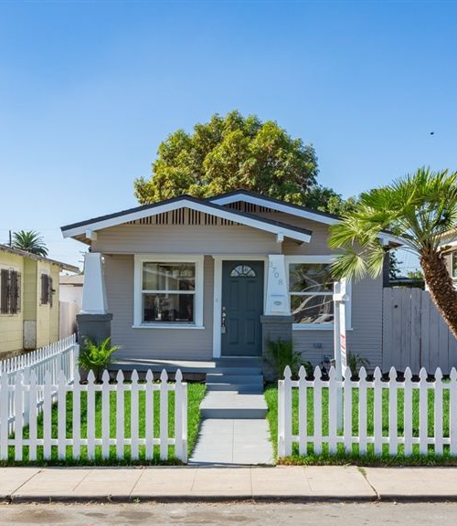

House Price Prediction
Group 2: William Aiken, Donald Butler, Michael Ippolito, Bharani Nittala, and Leticia Salazar
Notes:
Hi Everyone, my name is Leticia Salazar and I will be presenting our final project on house price predictions on behalf of Group 2 composed of William, Donald, Michael and Bharani.

Slide 2
Agenda
1. Introduction
1.1 Plots
2. Methodology
2.1 Results and Discussion
3. Conclusion and Future work
Presentation Title
Notes:
For our presentation I will introduce our project, show visualization on our data, go over our methodology and discuss our results, conclusion and future work.

Slide 3

Introduction
With the housing market affected by factors such as mortgage rates, inflation, or economic recession, housing prices have risen dramatically over the years.
We used a multivariate linear model to predict housing prices using factors as house area, number of bedrooms, whether it is furnished, nearness to a main road, and the presence of amenities like basements and guest houses.
Notes:
The housing market pricing changes can be affected by factors such as mortgage rates, inflation, or economic recessions, to name a few. From 1950 to the present, we witness home price fluctuations, with some steady rising periods between 1950s to the late 1980s. According to the article from Better.com (Johnson, 2022), if we start analyzing the median home value we note that house price growth has risen 326.1% since 1950 with a current median home price of $336,900 (inflation-adjusted to 2020 dollars). There was a 90% drop in production of new homes before the Great Depression started, and, in 1956, President Dwight D. Eisenhower passed the Federal Aid Highway Act that enabled the possibility to access a suburban way of life. By 1960, the boom of home ownership caused home prices started to increase. The Federal Housing Administration (FHA) created changes that allowed Americans to afford homes after WWII which contributed to the rise of home ownership and prices. With a median home price increase of 42.8% by the 1970s, the US economy saw inflation rising and, with it, the housing market. Fast forward to the 1980s, when there were high unemployment rates that caused mortgage interest rates to rise even more. During this time, the median home price (inflation-adjusted to 2020 dollars) had an average interest rate for a 30-year fixed mortgage of 13.7%. By the 1990s, the recession had ended and the housing bubble burst affected only major cities like New York, Boston, Los Angeles, San Diego, Washington D.C., and San Francisco. Entering the 21st century, the average interest rate for a 30-year fixed mortgage was down to 8.1%, as another recession was not expected. By 2008, the US faced challenges that pushed more than 10 million Americans to lose their homes and 9 million to lose their jobs. In 2020, the average interest rate for a 30-year fixed mortgage was 3.1%, with a record-setting year for housing prices. Now we can’t forget the pandemic of COVID-19 that left many to work from home. How does this contribute to the housing prices? Due to the pandemic, housing prices rose once again only to drop in some cities where the demand for homes wasn’t as high. It is believed that housing prices will soon level off and slow down but that mortgage rate will continue to rise.
In this project, we built a model to predict housing prices based on such factors as house area, number of bedrooms, whether it is furnished, nearness to a main road, and the presence of amenities like basements and guest houses. We used a multivariate linear model against a data set of 545 houses. We augmented the model by performing log transformation on the response variable (price) and by Huber-weighting the model by performing robust regression. Based on our model analysis, the basic assumptions of linear modeling are valid, with the exception of the presence of non-normally distributed residuals. However, this is less of an issue if the data set is large enough compared to the number of predictors. The resulting model performed reasonably well, yielding an adjusted R-squared value of 0.710 against our training data and 0.709 against the validation set. Confounding factors may be present but missing from the data set, as there were some outliers that could not be explained by any of the available predictors.

Slide 4




A little more about our data
Contains
Missing in action
545 observations and 13 variables
Data didn’t specify what the variable ‘prefarea’ represented
Gathered from
Prep Work
Kaggle.com
No missing variables
Notes:
Our data was gathered from Kaggle.com and consisted of 545 records and 13 variables. Once we started exploring our data we found that there were no missing values, we had to split the data into 70-30 ratio to have a training and evaluation data and the data didn’t specify what the variable prefarea represented.

Slide 5
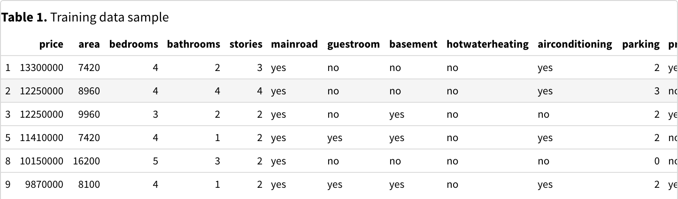
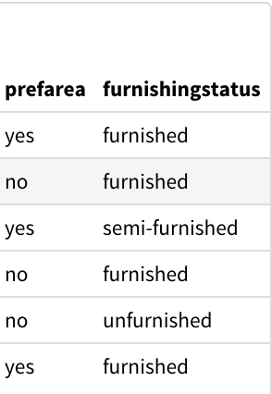
Our training data:
Notes:
Here’s a quick look at our training data, overall the data set contained homes with prices above 1 million. We also had to create dummy variables for most of our variables except price, area and parking. In terms of the unknown definition for prefarea, we assumed that this is a yes/no value indicating whethe the house is in a preferred neighborhood and we expect houses with a yes to have a higher price.

Slide 6
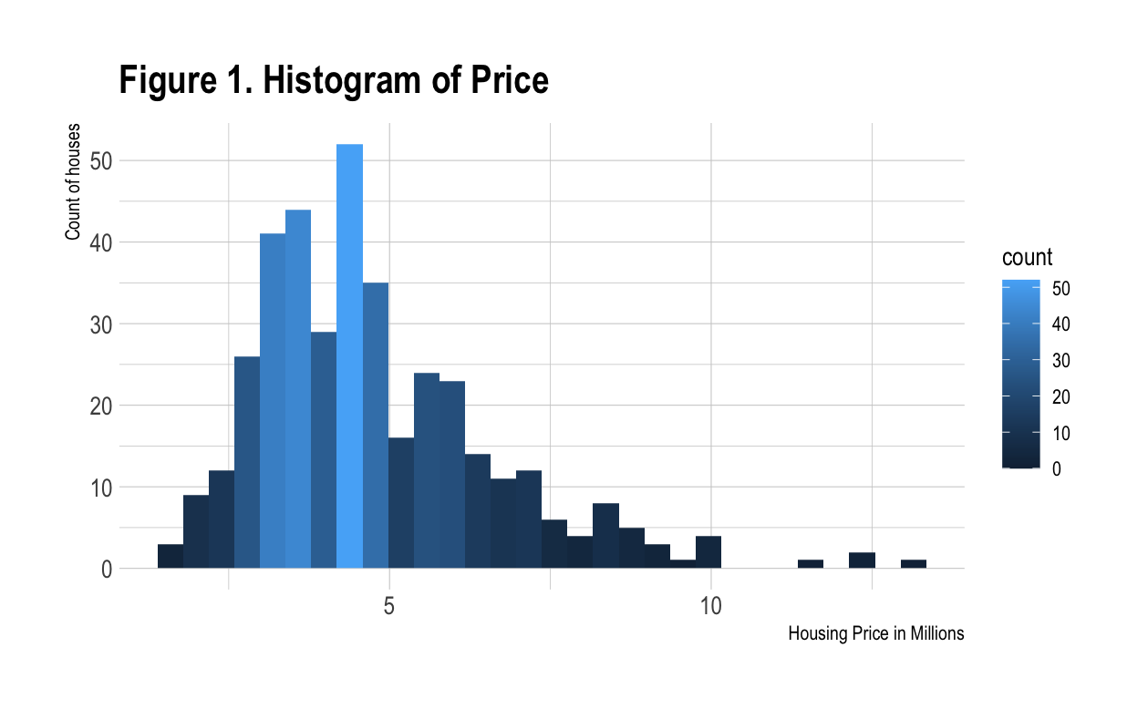
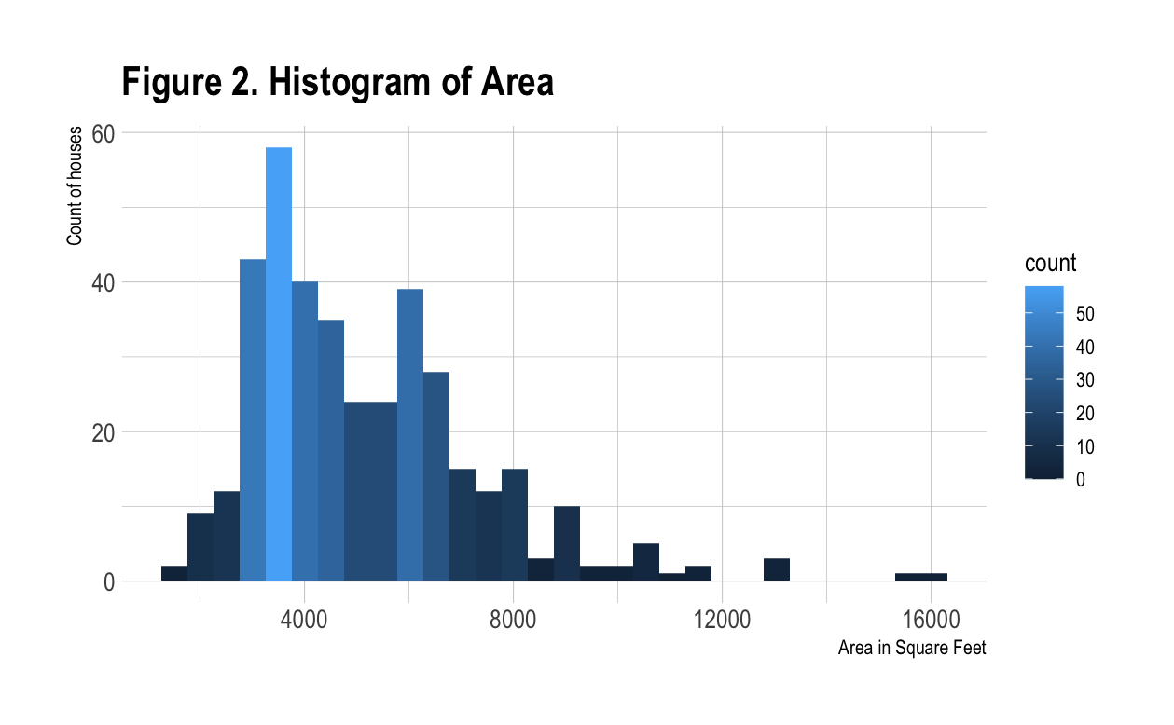
Data contains houses priced above 1 million
We expect that increases in area would lead to increases in price
Notes:
Here we note the distribution of the house prices where the prices are in millions. From the plot we notice that the prices are mainly right skewed with majority of the house prices falling below 5 million. We also show a distribution for the area in square feet of these homes, which is also right skewed and majority of the homes fall below 8000 sqft.

Slide 7
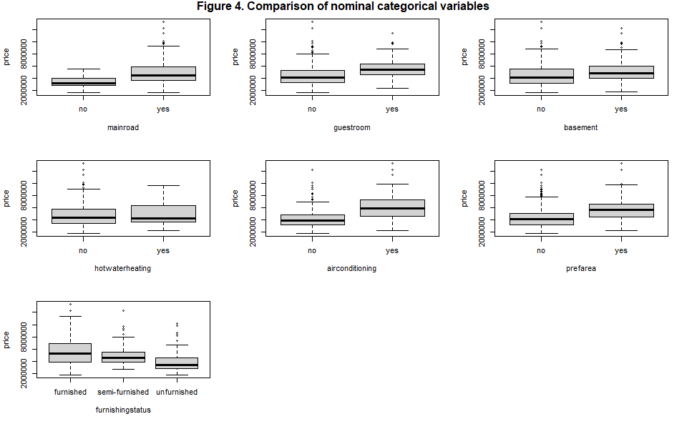
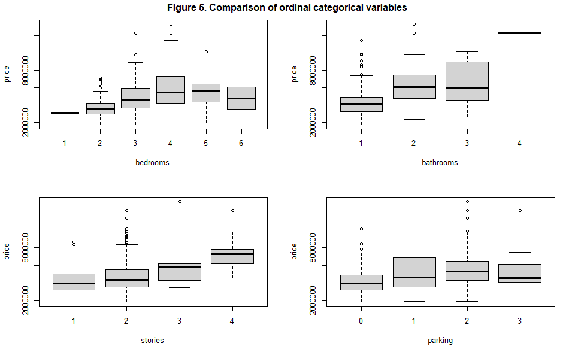
Box plots of nominal and ordinal categorical variables
Notes:
The boxplots above were divided into nominal and ordinal categorical variables. We note that pricier homes had guestrooms, basements, air conditioning, four bedrooms, four stories, two-car garages and two or more bedrooms. It also made sense that unfurnished homes in preferred areas had significantly higher median values. Surprisingly, houses with five and six bedrooms had median values below houses with only four bedrooms. It was also surprising that homes with three-car garages had median prices below those with only two-car garages. Also counter-intuitively, house on a main road increased the median home value. This could indicate that we misinterpreted the variable and that it perhaps indicates that a main road is only readily accessible, rather than in close proximity.

Slide 8
Methodology
Evaluation
Examined
Normal of residuals
Homoscedasticity of residuals
Independence of predictors
Linearity of fit
Predictors to evaluated how they might affect the response variable (price)
Assessed
Model Building
545 records and determined multiple linear regression model was appropriate
Preparation
Linear model against the full data
Stepwise to reduce the predictor
Split our data into a training and evaluation set
Created dummy variables
Notes:
Our methodology break down: First, we assessed the data to get an insight on what we were working with and to later determine what multiple linear regression model would be appropriate to use. We examined various predictors to evaluate qualitatively how they might affect our response variable (price). We also compared predictors against each other to look for signs of colinearity. Our data consists of both quantitative and categorical variables, the latter of which required factoring to use in our modeling. To prepare for modeling, we split our data into a training and evaluation set in order to properly make predictions. We then took the approach of attempting a linear model against the full dataset, followed by stepwise reducing the predictors to a leaner set. At each stage, we examined the adjusted R- squared value to determine model fit. We also evaluated the model to validate the underlying assumptions upon which linear models are based, namely:
• Normality of residuals • Homoschedasticity of residuals
• Independence of predictors • Linearity of fit
The model-building process started with three models created.
Model 1 lm_mod1 was run against the whole data set and yielded an Adjusted R-squared of 0.6755
Model 2 lm_mod2 used stepAIC and generated an Adjusted R-squared of 0.6767
Model 3 lm_mod3 was created to reduce colinearity and remove low values and yielded an Adjusted
R-squared of 0.6703

Slide 9
Methodology
Evaluate Homoscedasticity
Results…
Used Breusch-Pagan test
Evaluate Normality
Used Shapiro test
Evaluate Colinearity
Evaluate Outliers
Looked into variance inflation factors (VIFs)
Looked at hat values and compare them to a cutoff point
Notes:
To evaluate normality of residuals, we used the Shapiro test for normality. We used the Breusch-Pagan test to evalute homoschedasticity of residuals. In addition, we examined colinearity problems by looking at variance inflation factors (VIFs). We also evaluated outliers by looking at hat values and comparing them to the a cutoff point based on 2 * (p + 1) / n, where p is the number of parameters and n is the number of observations .
Based on our initial modeling attempts, there were no problems with linearity of fit or colinearity among the predictors. However, it was evident that the residuals were heteroschedastic and not normally distributed. We attempted to correct for these problems by applying a log transformation to the response variable (price). While this did yield homoschedastic residuals, they remained non-normally distributed. To attempt to correct for this, we attempted a Huber-weighted robust model. While this didn’t fully correct the issue, we note that in larger datasets, non-normality of residuals doesn’t significant affect model results (Schmidt, 2018), particularly those in which the number of records exceeds ten times the number of predictors. We also examined outliers to evaluate whether there was any trend evident in the data. However, we could discern none, and, therefore, we removed the most significant outliers to attempt a better fit.

Slide 10
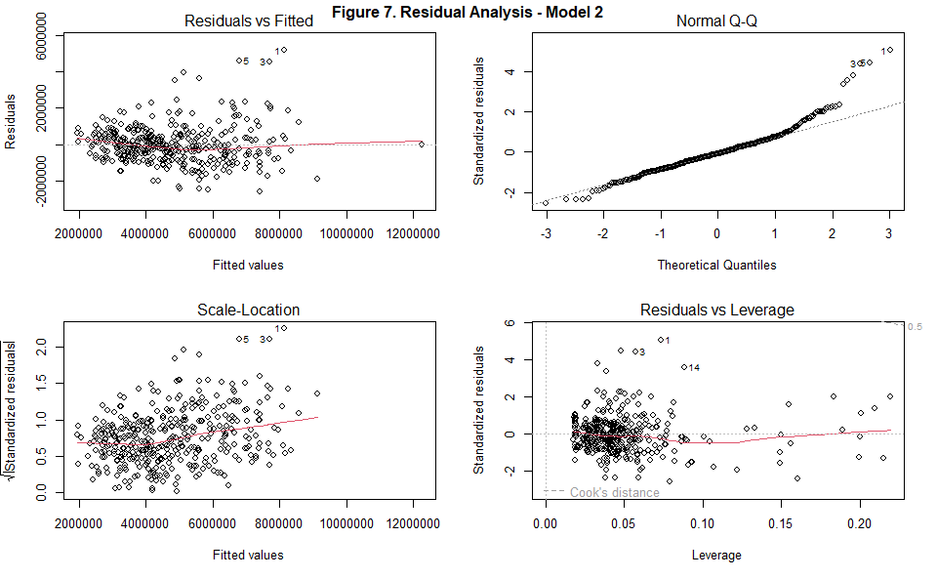
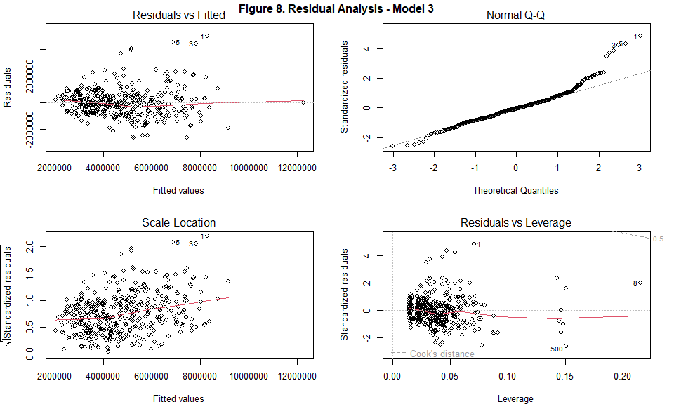
Results of Model
Our model showed:
Residuals were heteroscedastic
Not normally distributed
There were no problems with linearity of fit or colinearity among the predictors in our initial modeling attempts
Notes:
We developed a function to validate the underlying assumptions of the linear model and evaluated each model against the function. We concluded that residuals were neither normally distributed nor homoschedastic, presenting a problem with the underlying assumptions (Figures 7 and 8). This is confirmed quantitatively using the Shapiro test for normality, which yielded a p-value of 1.33x1011. We used the Breusch-Pagan test for homoschedasticity which also yielded a low p-value (9.25x108), confirming that the residuals are heteroschedastic.

Slide 11
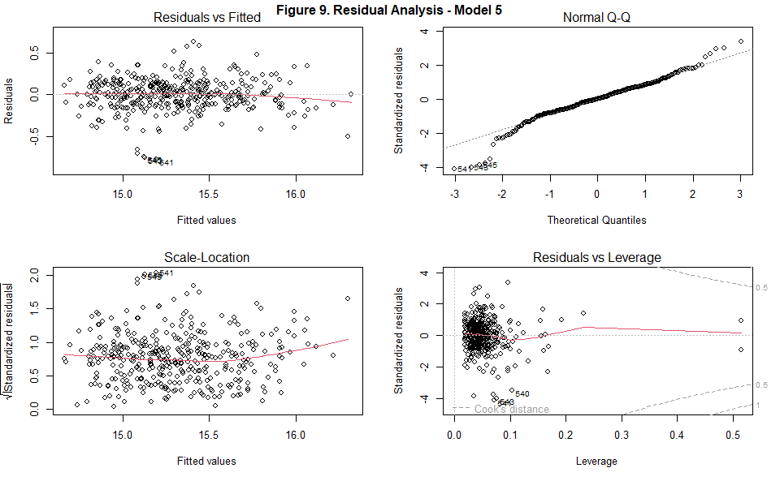
Results of Model
To fix our issues shown in Figures 7 and 8
we chose to run a Box-Cox transformation to give us an idea of whether a transformation of the response variable would be appropriate
We also implemented the the Shapiro and Breusch-Pagan tests to obtain the results shown in Figure 9
Residuals were now homoscedastic with the highest VIF of 2.04
Demonstrated slight colinearity among some variables
Notes:
Because of these issues, we chose to run a Box-Cox transformation to give us an idea of whether a trans- formation of the response variable would be appropriate. The Box-Cox transform resulted in a value of 0.082 on the price variable, indicating that a log transformation would be appropriate. A new model was run and step-reduced, transforming price to use a log scale. While the Shapiro test for normality yielded a higher p-value (0.0274), it still indicated that the residuals were not normally distributed. However, the Breusch-Pagan test resulted in a p-value of 0.221, indicating that the residuals were homoschedastic, a key validation factor. Further, the highest VIF was 2.04, indicating only slight colinearity among some variables. Figure 9 shows the residual analysis visually.
To evaluate the non-normality issue, we examined the most significant outliers (Table 2). There were no obvious indications of a pattern that may have reflected some problem with the model. This could indicate that there are one or more additional variables at play that influence price but are not present in our data set, for example high-end appliances or fixtures, the presence of a pool, or the condition of the property. To attempt to correct for the problem of non-normality, we removed the ten most significant outliers and reran the model, again step-reducing the model to remove non-significant predictors. Unfortunately, the residuals remained non-normally distributed (Figure 10).
In a further attempt to account for the normality problem, we ran a robust linear regression model against the dataset, which yielded a set of weights that we plugged into our linear model. Most weights were 1.0 (Figure 11), indicating that the majority of observations did not need any weighting. The model yielded a significant increase in adjusted R-squared (0.71 compared with 0.68 on the previous run). However, we still had the problem of non-normality of residuals (Figure 12). We tried again to remove the most significant outliers, but that neither increased the adjusted R-squared value nor removed the non-normality issue (Figure 13). To evalutate whether this would invalidate our model, we consulted the literature and found that there is good precedent for ignoring non-normally distributed residuals in datasets that have at least 10 observations per variable (Schmidt, 2018). Since our dataset contains at least that many observations, we can reasonably conclude that the problem of non-normality can be ignored for the purposes of our evaluation.
Based on this assumption, we performed five-fold cross-validation of the model. The adjusted R-squared value remained at 0.71. The final model used a log transformation of price against the following significant predictors:
• bed3 • bed4 • bath2 • floor2 • floor3 • floor4plus
• car1
• car2 • semifurnished
• furnished • ac • neighborhood

Slide 12
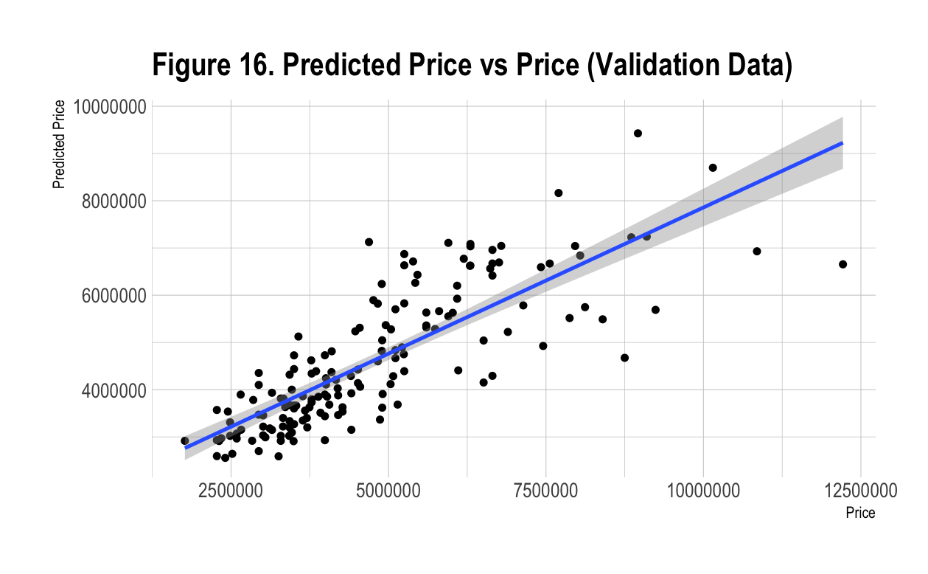
Results of Model
We then:
Applied a log transformation to the response variable (price)
Yielded homoscedastic residuals but still non-normally distributed
Attempted a Huber-weighted robust model
Didn’t fully correct the issue but noted that in larger data sets, non-normality of residuals doesn’t affect model results significantly.
In addition:
Examined outliers to evaluate any evident trends
Perceived none
Removed the most significant outliers to attempt a better fit
Final product
Notes:
Using the final model parameters, we generated the predicted prices in the training data and graphed the data against the actual price (Figure 14). This shows a visually good fit. We then repeated the procedure against the validation dataset, analyzed the residuals (Figure 15), and generated an adjusted R-squared value of 0.71, confirming that our model performed equally well against the validation set. Figure 16 visually confirmed the fit.

Slide 13
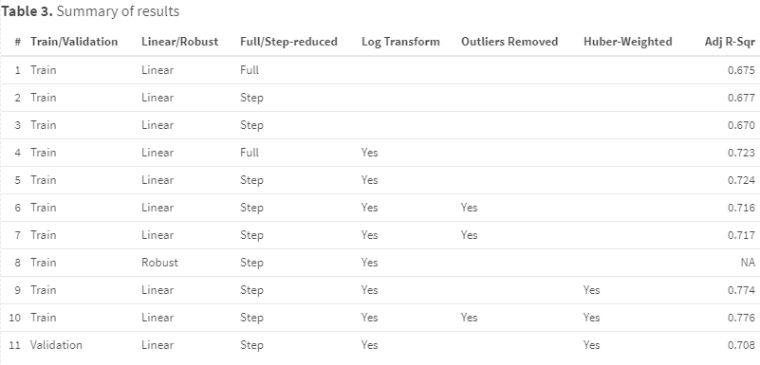
Conclusion
We found we were somewhat limited by the data set, in that there appeared to be one or more confounding variables that influenced price and that were not present in the data set.
Notes:
As a result of our work, we were able to develop a model that performed reasonably well under training conditions and only slightly poorer for the validation set ((0.710 adjusted R- squared alues of 0.710 and 0.709, respectively). The best linear model used a log transformation on price and 16 predictor variables, weighted using Huber weights determined by robust regression. While the residuals were not normally distributed, the assumptions of linearity, independence of variables, and homoschedasticity of residuals were validated.

Slide 14


Future work
Future research could be done to obtain a richer set of data with additional explanatory variables.
That could also mitigate the other limitation we encountered: that of non-normally distributed residuals.
Based on our literature review, that limitation may be less important, as our data set was fairly large compared to the number of explanatory variables.
Notes:
We found we were somewhat limited by the data set, in that there appeared to be one or more confounding variables that influenced price and that were not present in the data set. Future research could be done to obtain a richer set of data with additional explanatory variables. That could also mitigate the other limitation we encountered: that of non-normally distributed residuals. However, based on our literature review, that limitation may be less important, as our data set was fairly large compared to the number of explanatory variables.

Slide 15



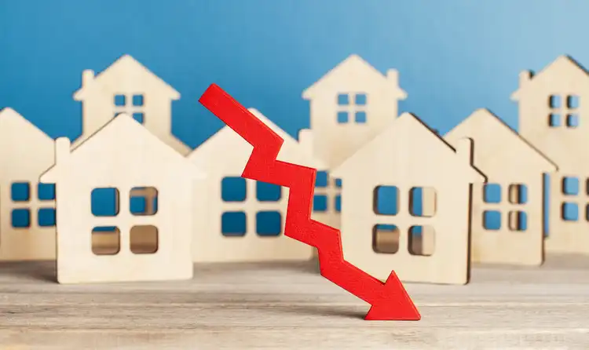
Thank you!
-- Group 2
References / Bibliography
H, M. Y. (2022, January 12). Housing prices dataset. Kaggle. Retrieved November 28, 2022, from https://www.kaggle.com/datasets/yasserh/housing-prices-dataset
Schmidt, A. (2018, June). Linear Regression and the normality assumption. Retrieved December 5, 2022, from https://doi.org/10.1016/j.jclinepi.2017.12.006
Johnson, N. (2022, May 24). How much home prices have risen since 1950: Better Mortgage. Better Mortgage Resources. Retrieved December 5, 2022, from https://better.com/content/how-much-home- prices-have-risen-since-1950/
Majumder, P. (2022, January 27). Using Sequential Model to Predict Prices of Real Estate. Retrieved December 5, 2022, from https://www.analyticsvidhya.com/blog/2022/01/using-sequential-model-to- predict-prices-of-real-estate/
Cuturi, M. & Etchebarne, G. (2021, June 25). Real Estate pricing with Machine Learning & non- traditional data sources. Retrieved December 5, 2022, from https://tryolabs.com/blog/2021/06/25/ real-estate-pricing-with-machine-learning--non-traditional-data-sources
Man, H. (2017, February 17). Prediction Model-Building a house price model. Retrieved December 5, 2022, from https://medium.com/hanman/data-modeling-building-a-house-price-prediction-model- 1450f825073b
Manjula, R. et al. (2017). Real estate value prediction using multivariate regression models. Retrieved December 5, 2022, from file:///C:/Users/micha/Downloads/Real_estate_value_prediction_using_ multivariate_re.pdf

